Slide 1
Excel Project Report – Bike Buyers Analysis
Debdatta Mukherjee

Slide 2
1. Project Overview
This project analyses customer demographics, lifestyle factors, and purchasing patterns to understand the key drivers behind bike purchasing behaviour.
The dataset includes 1,000 customer records with variables such as Income, Age, Education, Occupation, Marital Status, Region, and whether they purchased a bike or not.
2. Objective
To identify which factors most influence bike purchase decisions and present insights through an interactive Excel dashboard.

Slide 3
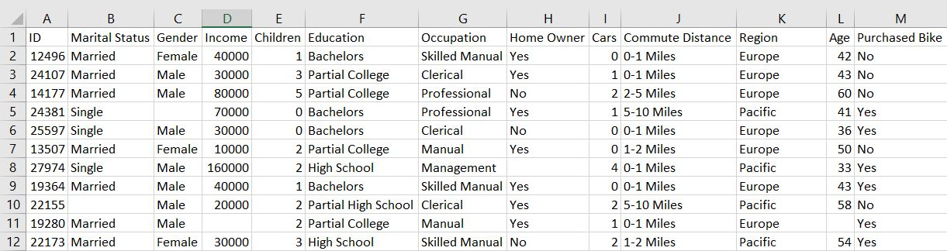
2. Dataset Description
Total Records - 1000 [=COUNTA(bike buyer[ID])]

Slide 4
3. Data Cleaning & Preparation
Steps performed:
  Loaded dataset into Power Query from Excel.
  Checked for null values using Column Quality and Column Distribution features.
  Replaced missing values in categorical columns.
  Replaced missing numeric values median values.
Standardized data types:
  Converted Income, Cars, Age, Children → to numeric.
  Purchased Bike, Marital Status, Gender → to text.
Loaded cleaned data into Excel worksheet for analysis.

Slide 5
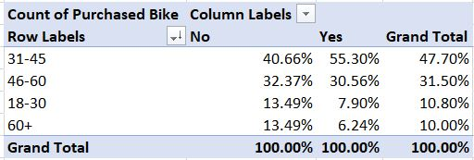
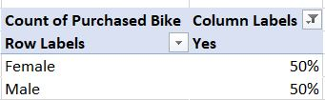
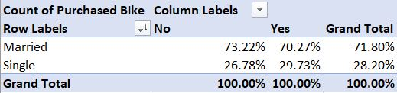
Demographic Analysis
Which age group has the highest rate of bike purchases?
Does gender influence purchasing behaviour?
How does marital status affect the likelihood of buying a bike?

Slide 6

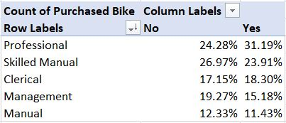
Income & Occupation
What is the average income of bike buyers vs. non-buyers?
Which occupation groups contribute most to bike purchases?

Slide 7
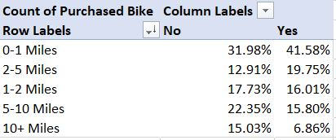
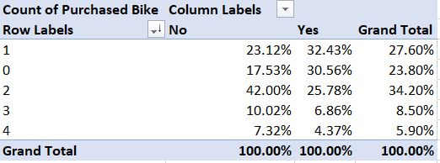
Lifestyle Insights
How does commute distance affect the probability of owning a bike?
Do people with more cars tend to buy fewer bikes?

Slide 8
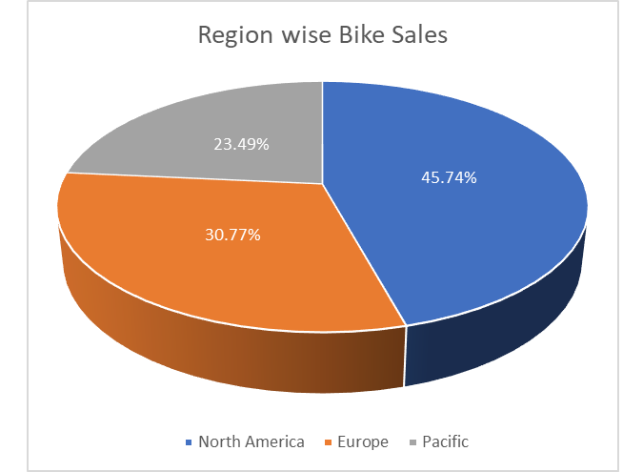
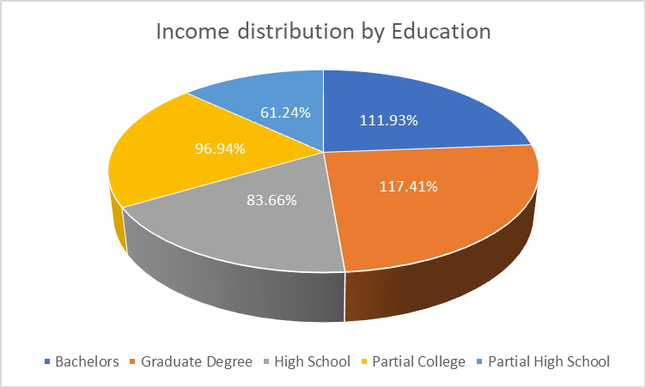
Regional Analysis
Which region has the most bike buyers?
What is the income distribution by education?

Slide 9
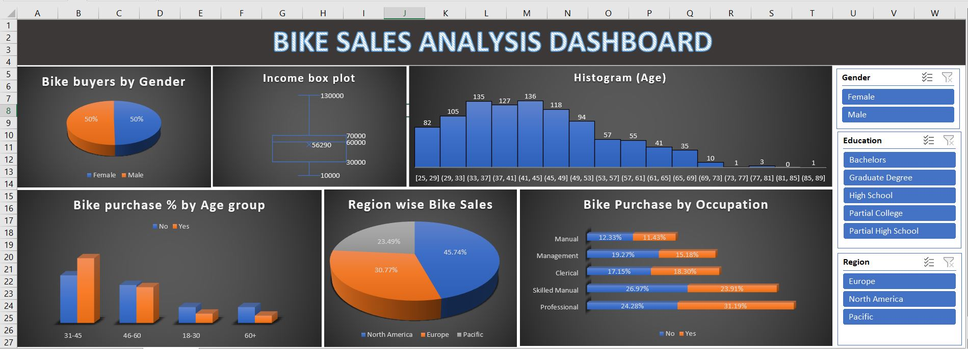
Dashboard

Slide 10
Summary of Key Findings
Highest bike purchase rate: Age 31–45, Professionals, Married, North America region
Average buyer income: ₹57,817/-
Most likely buyer: Professional aged 31–45, living in North America region, short commute (<5 miles), owning ≤1 car.

Slide 11
Conclusion
This analysis helped uncover key demographic and behavioral trends influencing bike purchases. It demonstrates the power of Excel with Power Query for real-world data analytics, enabling actionable insights and data-driven marketing strategies.

